Slide 1

FLAVOUR FUSION (cloud computing project)
HAFEEZAH BINTE ABDUL KASIM
2201536F

Slide 2

INTRODUCTION
In our modern, fast-paced society, uncovering the ideal recipe can pose a challenge. As passionate cooking aficionados and food enthusiasts, the quest for novel and delightful dishes is a constant pursuit, often fraught with difficulty. This inspired me to create Flavour Fusion, a unique online platform tailored to assist individuals in discovering exceptional recipes on a personalized level.

Slide 3
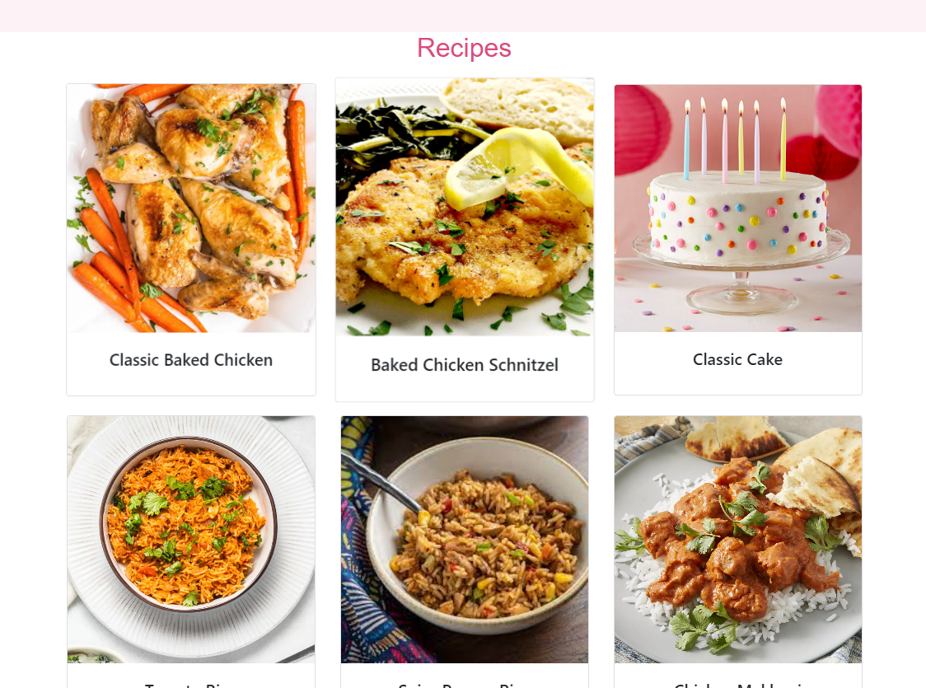
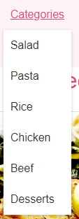
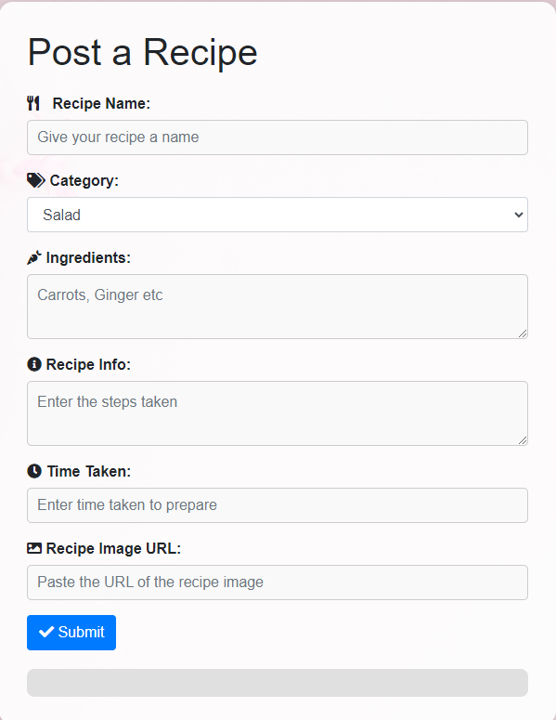
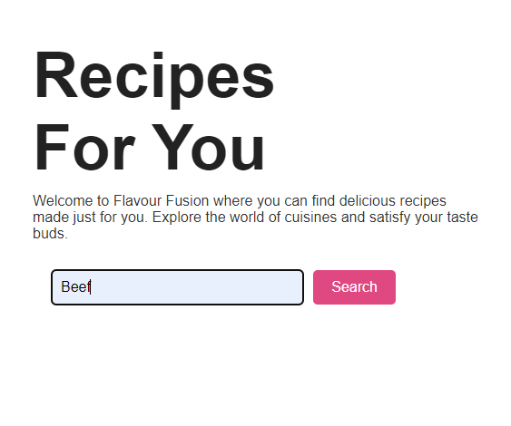
Features
Recipes page – display list of recipes
Dropdown Categories for Filtering – ‘salad, chicken, beef etc’
Search Bar Functionality – filtering based on search query
Add Recipe Functionality – allow users to post recipes
Recipe Details in Cards – show all recipe details (time taken, ingredients etc)
Food Culture Section – food culture articles
About Us Page –about website information
Log In/Sign Up – user account creation and log in

Slide 4
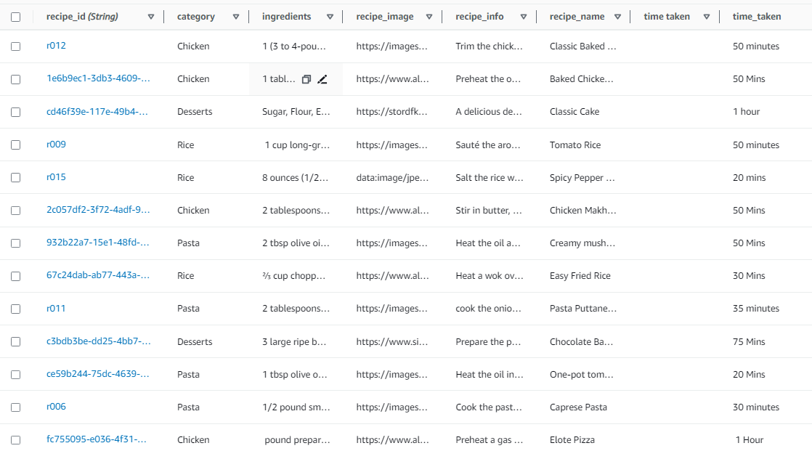
Creation of Database (DynamoDB)
Employed Amazon DynamoDB for organized recipe data management.
Utilized separate DynamoDB tables for recipe details and food culture information.
Enhanced user experience and website responsiveness through streamlined data storage.
Stored essential recipe details in the recipes table, including category, ingredients, image, info, name etc.
I used DynamoDB to store website data because of its seamless integration with AWS services like Lambda, enabling smooth backend interaction. It accommodates diverse data types within a single table, enhancing adaptability and user experience.
Recipes table

Slide 5
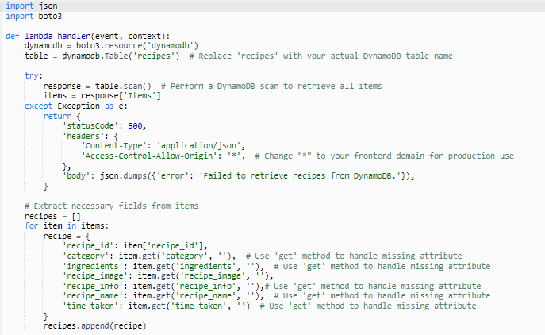
Lambda Functions
I used AWS Lambda to write my functions. It takes care of important tasks like getting recipes, using filters, and adding new recipes. Instead of a regular server, I have these handy Lambda functions to handle requests and do the work.
Fetching Recipes: Lambda triggers when users request recipes, retrieving them from DynamoDB and sending them back. This avoids maintaining a separate server for retrieval, saving resources.
Applying Filters: Lambda also filters recipes based on user preferences, easing server load and improving scalability.
Adding New Recipes: Lambda manages new recipe submissions, ensuring proper storage in DynamoDB after validation and formatting.
Culture Articles: User-requested articles are fetched from the database and returned through Lambda, enhancing content accessibility.

Slide 6
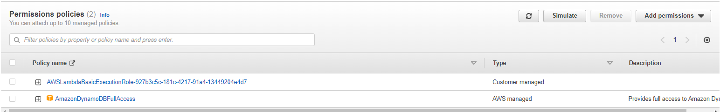
Permissions and IAM Roles
For the execution role, I used an existing role which I created under the IAM roles console. I created a role with a set of permissions
I created a getRecipes role with the permission to have access to the DynamoDB so that it can access the table and get the items needed. Using this IAM role is good practice as It enhances security.
IAM Role: The "getRecipes" IAM role functions as a permissions bundle that dictates what actions my Lambda function can perform within AWS resources. By assigning this role to the Lambda function, I grant it the authorization to interact with various AWS services, including DynamoDB.

Slide 7
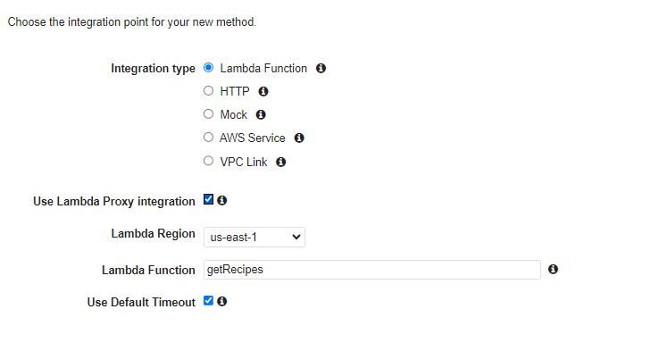
API Gateways
Amazon API Gateway Integration:
Utilized Amazon API Gateway to create and deploy APIs for my Lambda functions.
API Gateway simplified infrastructure management and scaling, mapping RESTful endpoints directly to Lambda functions.
Seamless Lambda Function Triggering:
Integrated each Lambda function with API Gateway.
Incoming HTTP requests to API Gateway endpoints triggered corresponding Lambda functions, enabling user interactions like fetching recipes or applying filters.
I chose the Lambda function integration type for API Gateway, enabling direct invocation of the function in response to API requests. I then established 'GET' and 'POST' methods for functions like fetching and posting recipes, culminating in the deployment of the API.

Slide 8
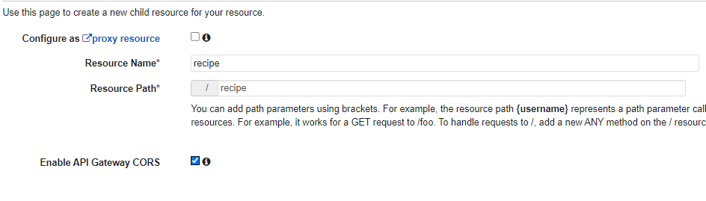

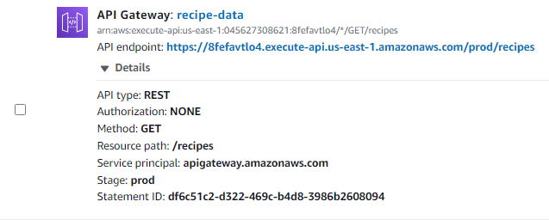
Deployment Of APIs
Resource Naming and CORS: Assigned the resource name and paths such as ('/recipe') while enabling API CORS gateway.
Invoke URL for Frontend: After deploying the API, obtained the invoke URL for accessing API data from the frontend.
CORS Significance: Enabled CORS to prevent browser blockage of cross-origin requests, guaranteeing smooth interaction between frontend and backend APIs.
In the "Triggers" section of my Lambda function, I see the API endpoint, confirming successful integration with API Gateway. This integration lets my Lambda function respond to incoming HTTP requests directed at the API endpoint, executing its code accordingly.

Slide 9
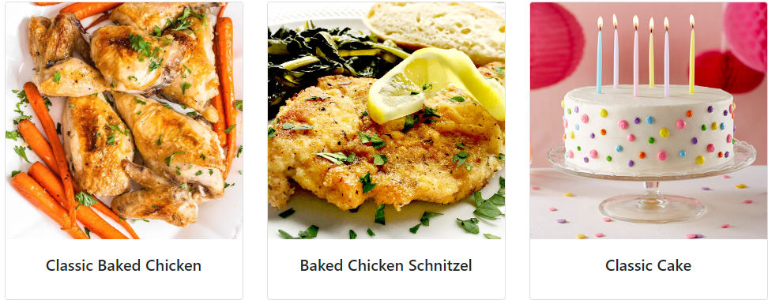
List of APIs and Front-End Integration
Fetch all recipes and filter by category: [/recipes, /categories]
Posting recipes from the front end (form.js): I also added other validation to ensure user types in all the fields correctly. [/add]
Filter based on search query: Included URL query string parameters like q (which stands for "query") in the search bar filter is a common convention used to pass search terms or criteria to APIs. URL query string might look like this: https://api.example.com/recipes?q=vegetarian [/search]
Fetch food culture articles: [/culture]
I've elegantly displayed recipes on the frontend using Bootstrap cards and pop-up modals. By integrating API invoke URLs with paths, I've streamlined data retrieval from DynamoDB, enhancing user experience and scalability. The outcome is a stylish interface where users can easily explore and enjoy culinary delights.

Slide 10
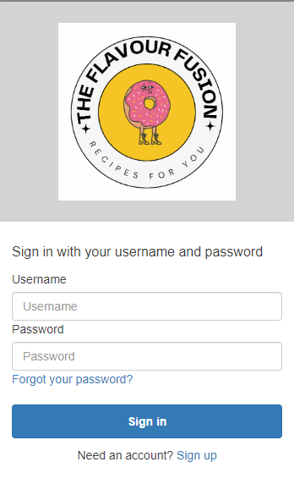
Log In/Sign up Using Cognito
Amazon Cognito Benefits:
Robust Security: Amazon Cognito offers strong data protection, encryption, and authentication practices for safeguarding user information.
User Authentication and Management:
Utilizing Amazon Cognito for logins and user pools enhances security and simplifies user-related tasks, ideal for applications requiring authentication and identity management.

Slide 11
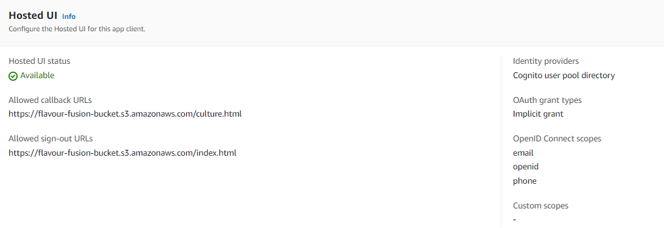
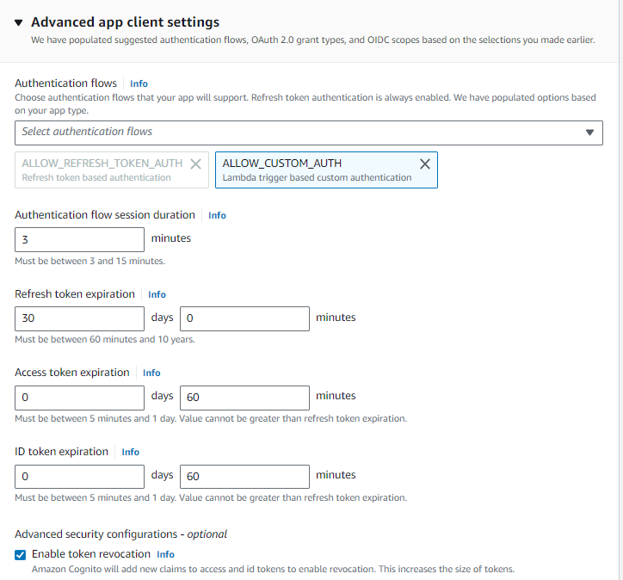
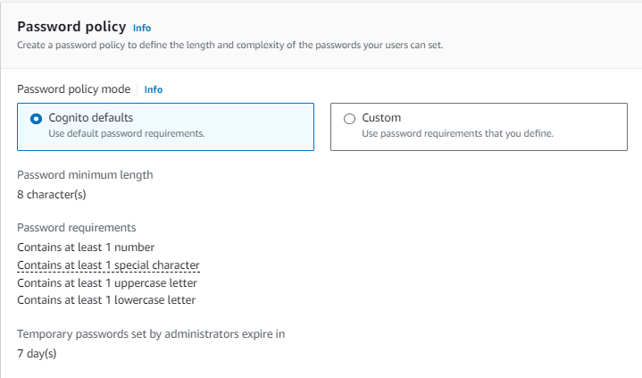
Settings and Configuration
Password Security:
Utilized Amazon Cognito's default password policy settings to ensure strong and secure user-generated passwords.
Email Verification:
Configured Cognito to send verification emails, enhancing user authentication.
Enabled "Admin User Password Auth" in advanced app client settings, empowering administrators to assist users with password-related matters and improve user support.
User-Friendly Authentication:
Employed Cognito's Hosted UI for registration and login, with customized callback URLs for successful logins and logout actions.
Chose the implicit grant type for OAuth, creating a seamless and secure authentication process that enhances user experience and simplifies navigation.

Slide 12
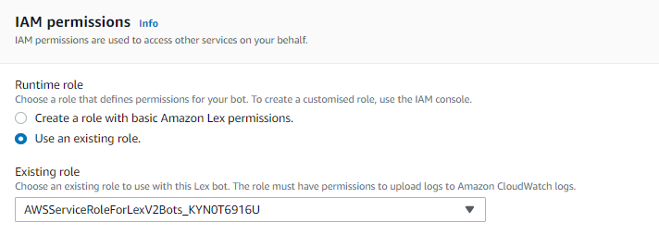
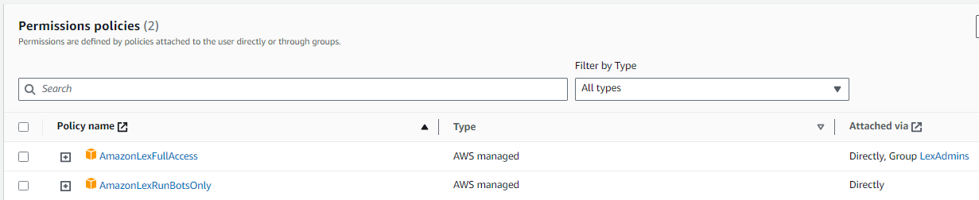
Implementing an AI feature with the use of Amazon LEX
To enhance website interactivity, I integrated an AI-powered chatbot using Amazon Lex, creating a dynamic and user-centric experience where users can engage naturally and receive personalized assistance through advanced natural language processing capabilities.
IAM Roles
For ensuring seamless connectivity between visible website components and Amazon Lex, I utilized a pre-existing role equipped with essential rules like AmazonLexFullAccess and AmazonLexRunBotsOnly.

Slide 13
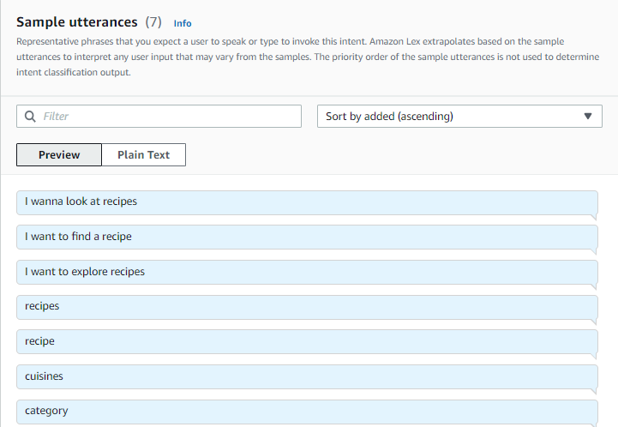
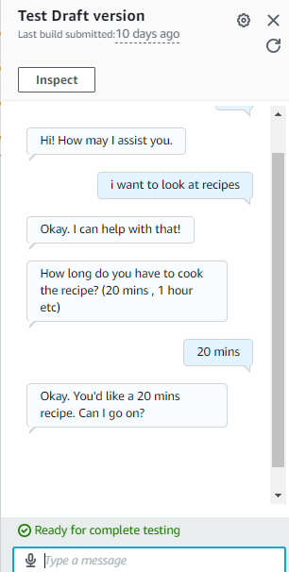
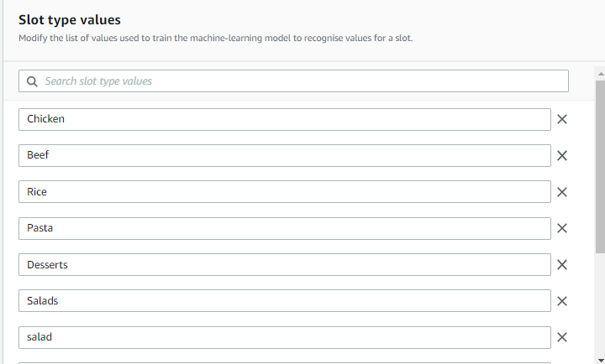
Building The Chatbot
Bot Construction - Intents and Slot Types:
Developed customized intents and slot types to enable effective communication between the user and the bot.
Interactive User Engagement:
Created a user-friendly chatbot that initiates conversations and prompts users for recipe preferences, subsequently offering tailored recipe suggestions, enhancing interactive user experience.
Testing:
After adding the necessary intents and slot types I built the bot and tested it out in amazon before deploying it to the front end

Slide 14
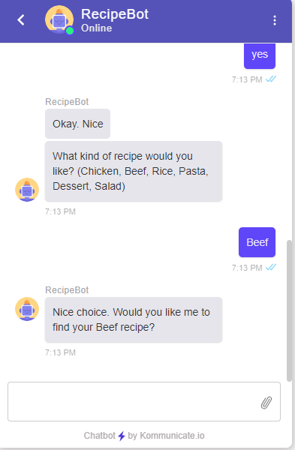
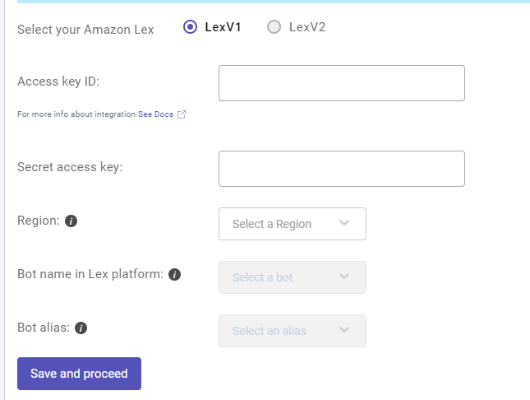
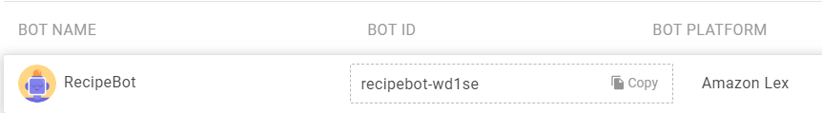
Integrating Lex to Front-End
LEX Bot Integration:
Deployed the LEX bot onto the website's front end to enhance interactivity.
Seamless Integration with Kommunicate:
Utilized Kommunicate, a third-party tool, to seamlessly connect Amazon LEX bots to the website's interface.
Enhanced User Experience:
Through Kommunicate, established a user-friendly interface for the LEX bot, creating an intuitive and interactive experience that enriches the overall website usability.

Slide 15
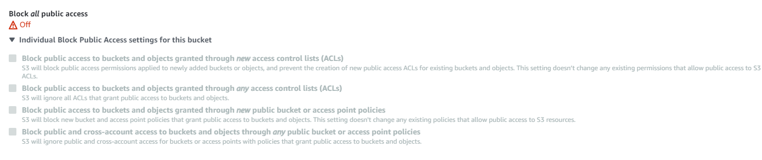
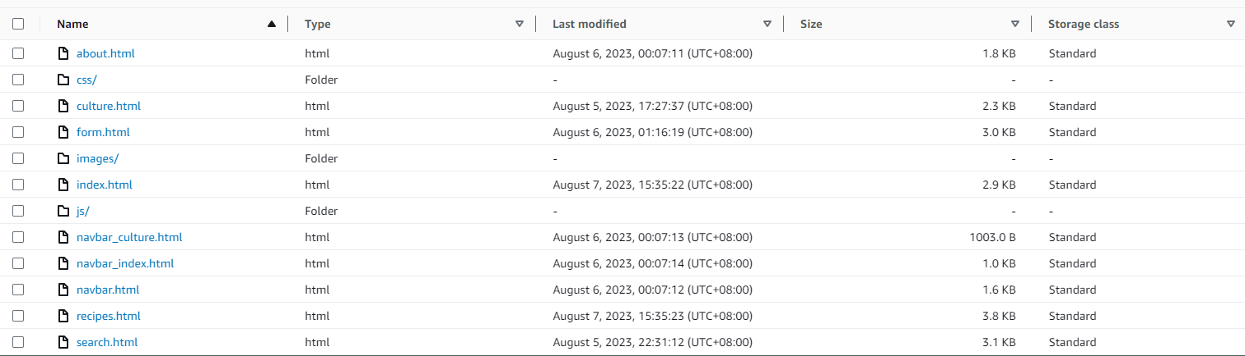
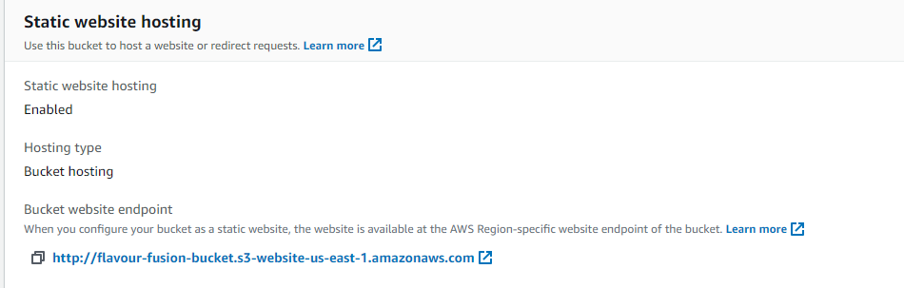
Deployment to S3
After finishing my website's development, I uploaded frontend elements (HTML, CSS, JavaScript) to Amazon S3. This ensures secure storage and accessibility worldwide, and scalability benefits. Serverless deployment improves load times, user experience, and overall online reliability.
I created a ‘flavour-fusion-bucket’ which contains all my static website files.
Permissions and settings:
By unchecking "Block all public access" in Amazon S3, I've enabled unrestricted public access to my website's content so that everyone can have access
Enabled Static hosting

Slide 16
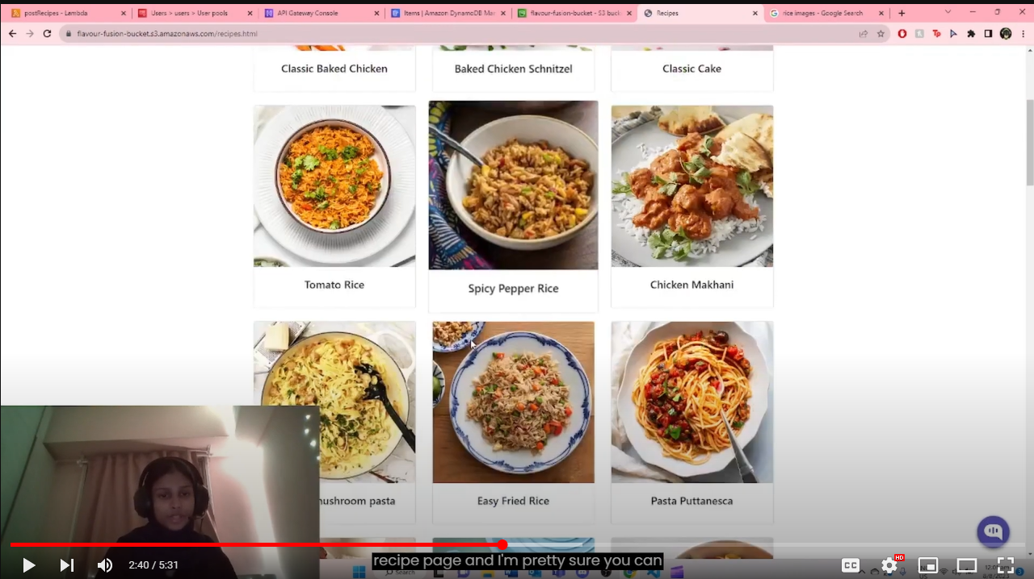
VIDEO DEMO
https://youtu.be/qrThBnlo0z8

Slide 17

Thanks!
Please keep this slide for attribution

